Slide 1
Hospital Management App
An application that lets customers register and find doctors to make appointments
A very simple app to showcase the connection of a front react project with a backend RESTful API build on Java - Spring.
Register form for customers and doctors, both of which hold different information.
A login form which on the backend interacts with a different entity that holds the login data.
After user has logged in, the side menu changes to the appropriate options:
Customers can see their appointments and make new ones, update or delete them.
Doctors can see their appointments, which can be from multiple customers!
Nikolaos Giagkinis – Boolean UK – Final project 2023

Slide 2
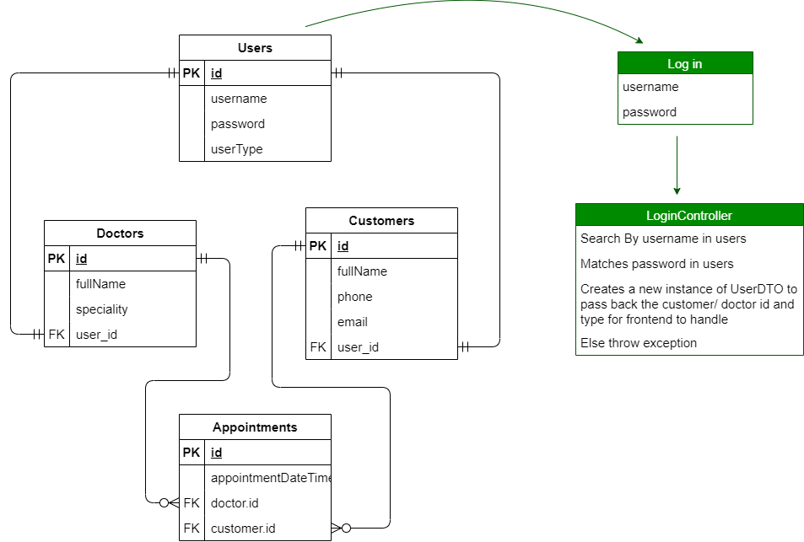
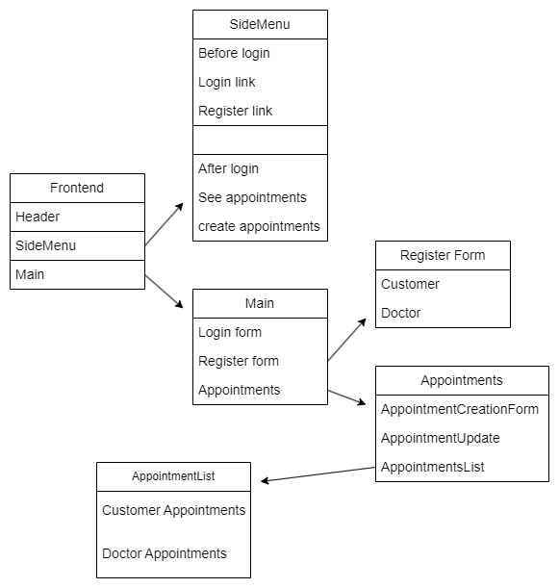
Project Logic
Nikolaos Giagkinis – Boolean UK – Final project 2023

